Slide 1


Data Structures III
Introduction to Computer Science
Shimon Schocken
IDC Herzliya
Lecture 10-1

Slide 2
Lecture plan
Generic classes
Wrapper classes
Data structures: Map

Slide 3
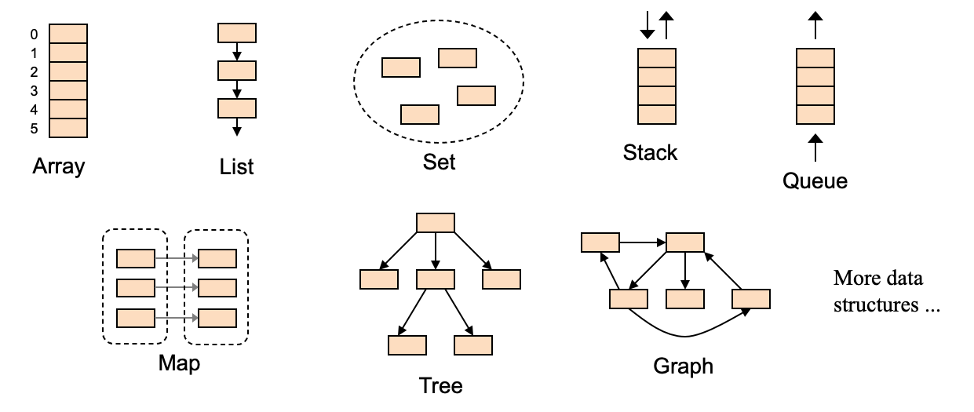
Data structures
Data structures are designed to store, and operate on, elements.
So far, for simplicity, the elements were assumed to be int values.
We will now extend the data structures classes to handle elements that are:
Primitive data types of any type
Objects of any type.

Slide 4
Using a generic List class
Output:
(7/8 6/7 5/6 4/5 3/4 2/3 1/2 3/4 1/2)
Client code (example):
// Uses a regular List class to
// represent a list of int values.
import lists*;
first
5
3
7
A list of int values

Slide 5
Using a generic List class
Output:
(7/8 6/7 5/6 4/5 3/4 2/3 1/2 3/4 1/2)
Client code (example):
Client code (example):
// Uses a regular List class to
// represent a list of int values.
import lists*;
...
// Constructs a list of integers:
List list = new List();
// Adds some int values to the list
list.addFirst(7);
list.addFirst(3);
list.addFirst(5);
// Prints the list
System.out.println(list);
// Prints: (5, 3, 7)
...
// Uses a generic List class to represent
// a list of Fraction objects.
import lists*;
...
Same as Lecture 9-2
first
first
5
3
7
A list of int values
2/3
3/4
1/2
A list of Fraction objects

Slide 6
Using a generic List class
Output:
(7/8 6/7 5/6 4/5 3/4 2/3 1/2 3/4 1/2)
Client code (example):
Client code (example):
// Uses a regular List class to
// represent a list of int values.
import lists*;
...
// Constructs a list of integers:
List list = new List();
// Adds some int values to the list
list.addFirst(7);
list.addFirst(3);
list.addFirst(5);
// Prints the list
System.out.println(list);
// Prints: (5, 3, 7)
...
// Uses a generic List class to represent
// a list of Fraction objects.
import lists*;
...
// Constructs a list of fractions (Fraction objects)
Same as Lecture 9-2
first
first
5
3
7
A list of int values
2/3
3/4
1/2
A list of Fraction objects

Slide 7
Using a generic List class
Output:
(7/8 6/7 5/6 4/5 3/4 2/3 1/2 3/4 1/2)
Client code (example):
Client code (example):
// Uses a regular List class to
// represent a list of int values.
import lists*;
...
// Constructs a list of integers:
List list = new List();
// Adds some int values to the list
list.addFirst(7);
list.addFirst(3);
list.addFirst(5);
// Prints the list
System.out.println(list);
// Prints: (5, 3, 7)
...
// Uses a generic List class to represent
// a list of Fraction objects.
import lists*;
...
// Constructs a list of fractions (Fraction objects)
List<Fraction> fList = new List<Fraction>();
// Adds some fractions to the list
fList.addFirst(new Fraction(1,2));
fList.addFirst(new Fraction(3,4));
fList.addFirst(new Fraction(2,3));
// Prints the list
System.out.println(fList);
// Prints: (2/3, 3/4, 1/2)
...
Generic class
Same as Lecture 9-2
first
first
5
3
7
A list of int values
2/3
3/4
1/2
A list of Fraction objects

Slide 8
Generic classes
Output:
(7/8 6/7 5/6 4/5 3/4 2/3 1/2 3/4 1/2)
Client code (example):
The lists package that we developed in lecture 9-2 (classes Node, List, ListIterator) is designed to create and manage lists of int values
If we wish to create and manage lists of any data type, we have to modify these classes, and make them generic.
That’s what we’ll do next.
// Uses a generic List class to represent
// a list of Fraction objects.
import lists*;
...
// Constructs a list of fractions (Fraction objects)
List<Fraction> fList = new List<Fraction>();
// Adds some fractions to the list
fList.addFirst(new Fraction(1,2));
fList.addFirst(new Fraction(3,4));
fList.addFirst(new Fraction(2,3));
// Prints the list
System.out.println(fList);
// Prints: (2/3, 3/4, 1/2)
...
Generic class
first
2/3
3/4
1/2
A list of Fraction objects

Slide 9
Generic Node class
Node class: Original version (not generic)
/** Represents a node in a linked list
* that holds an int value. */
public class Node {
int value; // data
Node next; // pointer
/** Constructs a node with the value
* and a pointer to the next node */
public Node(int value, Node next) {
this.value = value;
this.next = next;
}
/** Constructs a node with the value
* and a null pointer */
public Node(int value) {
this(value, null);
}
/** Textual representation of this node. */
public String toString() {
return "" + value;
}
}
Best practice:
If you want to create a class that handles generic elements, start by implementing a class that handles simple elements (like int values)
Then extend it to handle any object type
Same as Lecture 9-2
5
7
object of type T
object of type T

Slide 10
Generic Node class
Node class: Original version (not generic)
Node class: Generic version
/** Represents a node in a linked list
* that holds an int value. */
public class Node {
int value; // data
Node next; // pointer
/** Constructs a node with the value
* and a pointer to the next node */
public Node(int value, Node next) {
this.value = value;
this.next = next;
}
/** Constructs a node with the value
* and a null pointer */
public Node(int value) {
this(value, null);
}
/** Textual representation of this node. */
public String toString() {
return "" + value;
}
}
/** Represents a node in a linked list
* that holds an object of type T. */
public class Node<T> {
T: a placeholder that stands for any desired object type
Same as Lecture 9-2
5
7
object of type T
object of type T

Slide 11
Generic Node class
Node class: Original version (not generic)
Node class: Generic version
/** Represents a node in a linked list
* that holds an int value. */
public class Node {
int value; // data
Node next; // pointer
/** Constructs a node with the value
* and a pointer to the next node */
public Node(int value, Node next) {
this.value = value;
this.next = next;
}
/** Constructs a node with the value
* and a null pointer */
public Node(int value) {
this(value, null);
}
/** Textual representation of this node. */
public String toString() {
return "" + value;
}
}
/** Represents a node in a linked list
* that holds an object of type T. */
public class Node<T> {
T value; // data
Node next; // pointer
/** Constructs a node with the value
* and a pointer to the next node */
public Node(T value, Node next) {
this.value = value;
this.next = next;
}
/** Constructs a node with the value
* and a null pointer */
public Node(T value) {
this(value, null);
}
/** Textual representation of this node. */
public String toString() {
return "" + value;
}
}
T: a placeholder that stands for any desired object type
Same as Lecture 9-2
5
7
object of type T
object of type T

Slide 12
Generic Node class
Node class: Original version (not generic)
Node class: Generic version
/** Represents a node in a linked list
* that holds an int value. */
public class Node {
int value; // data
Node next; // pointer
/** Constructs a node with the value
* and a pointer to the next node */
public Node(int value, Node next) {
this.value = value;
this.next = next;
}
/** Constructs a node with the value
* and a null pointer */
public Node(int value) {
this(value, null);
}
/** Textual representation of this node. */
public String toString() {
return "" + value;
}
}
/** Represents a node in a linked list
* that holds an object of type T. */
public class Node<T> {
T value; // data
Node next; // pointer
/** Constructs a node with the value
* and a pointer to the next node */
public Node(T value, Node next) {
this.value = value;
this.next = next;
}
/** Constructs a node with the value
* and a null pointer */
public Node(T value) {
this(value, null);
}
/** Textual representation of this node. */
public String toString() {
return "" + value;
}
}
The letter T is just a placeholder.
Commonly used placeholders: T, S, E, V
T: a placeholder that stands for any desired object type
highlighting the differences
Same as Lecture 9-2
5
7
object of type T
object of type T

Slide 13
Generic List class
List class: Original version (not generic)
/** A linked list of integers. */
public class List {
private Node first; // Points to this list
private int size; // Number of elements
/** Constructs an empty list. */
public List() {
// Starts with a dummy node
first = new Node(0);
size = 0;
}
...
/** Adds the given value to
* the beginning of this list. */
public void addFirst(int val) {
Node newNode = new Node(val);
newNode.next = first.next;
first.next = newNode;
size++;
}
...
Best practice:
If you want to create a class that handles generic elements, start by implementing a class that handles simple elements (like int values)
Then extend it to handle any object type
Same as Lecture 9-2
first
first
5
7
2
object of type T
object of type T
object of type T

Slide 14
Generic List class
List class: Original version (not generic)
List class: Generic version
/** A linked list of integers. */
public class List {
private Node first; // Points to this list
private int size; // Number of elements
/** Constructs an empty list. */
public List() {
// Starts with a dummy node
first = new Node(0);
size = 0;
}
...
/** Adds the given value to
* the beginning of this list. */
public void addFirst(int val) {
Node newNode = new Node(val);
newNode.next = first.next;
first.next = newNode;
size++;
}
...
/** A linked list of generic values of type T. */
public class List<T> {
Same as Lecture 9-2
first
first
5
7
2
object of type T
object of type T
object of type T

Slide 15
Generic List class
List class: Original version (not generic)
List class: Generic version
/** A linked list of integers. */
public class List {
private Node first; // Points to this list
private int size; // Number of elements
/** Constructs an empty list. */
public List() {
// Starts with a dummy node
first = new Node(0);
size = 0;
}
...
/** Adds the given value to
* the beginning of this list. */
public void addFirst(int val) {
Node newNode = new Node(val);
newNode.next = first.next;
first.next = newNode;
size++;
}
...
/** A linked list of generic values of type T. */
public class List<T> {
private Node<T> first; // Points to this list
private int size; // Number of elements
/** Constructs an empty list. */
public List() {
// Starts with a dummy node
first = new Node<T>(null);
size = 0;
}
...
/** Adds the given value to
* the beginning of this list. */
public void addFirst(T val) {
Node newNode = new Node<T>(val);
newNode.next = first.next;
first.next = newNode;
size++;
}
...
Same as Lecture 9-2
first
first
5
7
2
object of type T
object of type T
object of type T

Slide 16
Generic List class
List class: Original version (not generic)
List class: Generic version
/** A linked list of integers. */
public class List {
private Node first; // Points to this list
private int size; // Number of elements
/** Constructs an empty list. */
public List() {
// Starts with a dummy node
first = new Node(0);
size = 0;
}
...
/** Adds the given value to
* the beginning of this list. */
public void addFirst(int val) {
Node newNode = new Node(val);
newNode.next = first.next;
first.next = newNode;
size++;
}
...
/** A linked list of generic objects of type T. */
public class List<T> {
private Node<T> first; // Points to this list
private int size; // Number of elements
/** Constructs an empty list. */
public List() {
// Starts with a dummy node
first = new Node<T>(null);
size = 0;
}
...
/** Adds the given value to
* the beginning of this list. */
public void addFirst(T val) {
Node newNode = new Node<T>(val);
newNode.next = first.next;
first.next = newNode;
size++;
}
...
highlighting the differences
Same as Lecture 9-2
first
first
5
7
2
object of type T
object of type T
object of type T

Slide 17
Using a generic List class
Client code (example):
List class: Generic version
import lists*;
/** A linked list of generic values of type T. */
public class List<T> {
private Node<T> first; // Points to this list
private int size; // Number of elements
/** Constructs an empty list. */
public List() {
// Starts with a dummy node
first = new Node<T>(null);
size = 0;
}
...
/** Adds the given value to
* the beginning of this list. */
public void addFirst(T val) {
Node newNode = new Node<T>(val);
newNode.next = first.next;
first.next = newNode;
size++;
}
...
Uses the services of:
first
Example: List of Fraction objects
2/3
3/4
1/2
first
object of type T
object of type T
object of type T

Slide 18
Using a generic List class
Client code (example):
List class: Generic version
import lists*;
...
// Constructs a list of fractions (Fraction objects)
List<Fraction> fList = new List<Fraction>();
// Adds some fractions to the list
fList.addFirst(new Fraction(1,2));
fList.addFirst(new Fraction(3,4));
fList.addFirst(new Fraction(2,3));
// Prints the list
System.out.println(fList);
// Prints: (2/3, 3/4, 1/2)
...
/** A linked list of generic values of type T. */
public class List<T> {
private Node<T> first; // Points to this list
private int size; // Number of elements
/** Constructs an empty list. */
public List() {
// Starts with a dummy node
first = new Node<T>(null);
size = 0;
}
...
/** Adds the given value to
* the beginning of this list. */
public void addFirst(T val) {
Node newNode = new Node<T>(val);
newNode.next = first.next;
first.next = newNode;
size++;
}
...
Uses the services of:
first
Example: List of Fraction objects
2/3
3/4
1/2
first
object of type T
object of type T
object of type T

Slide 19
Using a generic List class
Client code (Another example):
List class: Generic version
import lists*;
...
// Constructs a list of city names (strings)
/** A linked list of generic values of type T. */
public class List<T> {
private Node<T> first; // Points to this list
private int size; // Number of elements
/** Constructs an empty list. */
public List() {
// Starts with a dummy node
first = new Node<T>(null);
size = 0;
}
...
/** Adds the given value to
* the beginning of this list. */
public void addFirst(T val) {
Node newNode = new Node<T>(val);
newNode.next = first.next;
first.next = newNode;
size++;
}
...
Uses the services of:
first
"Haifa"
"LA"
"Paris"
first
object of type T
object of type T
object of type T

Slide 20
Using a generic List class
Client code (Another example):
List class: Generic version
import lists*;
...
// Constructs a list of city names (strings)
List<String> cities = new List<String>();
// Adds some cities to the list
cities.addFirst(new String("Haifa"));
cities.addFirst(new String("LA"));
cities.addFirst(new String("Paris"));
// Prints the list
System.out.println(cities);
// Prints: (Haifa, LA, Paris)
...
/** A linked list of generic values of type T. */
public class List<T> {
private Node<T> first; // Points to this list
private int size; // Number of elements
/** Constructs an empty list. */
public List() {
// Starts with a dummy node
first = new Node<T>(null);
size = 0;
}
...
/** Adds the given value to
* the beginning of this list. */
public void addFirst(T val) {
Node newNode = new Node<T>(val);
newNode.next = first.next;
first.next = newNode;
size++;
}
...
Uses the services of:
first
"Haifa"
"LA"
"Paris"
first
In general:
We can use a generic List class to construct, and manage, lists of any desired objects.
object of type T
object of type T
object of type T

Slide 21
Lecture plan
Generic classes
Wrapper classes
Data structures: Map

Slide 22

Wrapper classes
We wish the data structure classes to store, and operate on:
Primitive data types of any type
Objects of any type
A generic class is designed to store, and operate on, objects only
If we want the generic class to handle elements of a primitive data type (int, double, char, …), we must “box” the primitive values inside suitable objects
For this purpose, Java features a set of nine wrapper classes.

Slide 23
Wrapper classes
Java provides nine wrapper classes, also called boxed types.
Primitive types:
byte
short
int
long
float
double
boolean
char
void
Corresponding wrapper classes:
Byte
Short
Integer
Long
Float
Double
Boolean
Character
Void
Why do we need wrapper classes?
1. Because that’s the only way to make a generic class handle primitive data types
For example, if you want a generic Stack to handle double values, you have to wrap (“box”) the primitive double values in Double objects
2. Because wrapper classes provide other useful, type-specific, constants and services.

Slide 24
Wrapper classes
import lists*;
...
// Uses a generic List class to construct a list of integers
List<Integer> list = new List<Integer>();
first
Example: List of Integer objects
5
7
3

Slide 25
Wrapper classes
import lists*;
...
// Uses a generic List class to construct a list of integers
List<Integer> list = new List<Integer>();
// Adds some values to the list
fList.addFirst(new Integer(5));
fList.addFirst(new Integer(7));
fList.addFirst(new Integer(3));
...
// Gets the object in location 1 in the list:
Integer xObj = list.get(1);
// Gets the primitive int value “inside”:
int x = (int) xObj; // x is set to 7
// Java provides easier ways to work
// with boxed types.
// see examples on the right.
first
Example: List of Integer objects
5
7
3
Creating a “boxed” value:
Integer xObj = new Integer(19); // xObj points to an Integer object holding 19

Slide 26
Wrapper classes
import lists*;
...
// Uses a generic List class to construct a list of integers
List<Integer> list = new List<Integer>();
// Adds some values to the list
fList.addFirst(new Integer(5));
fList.addFirst(new Integer(7));
fList.addFirst(new Integer(3));
...
// Gets the object in location 1 in the list:
Integer xObj = list.get(1);
// Gets the primitive int value “inside”:
int x = (int) xObj; // x is set to 7
// Java provides easier ways to work
// with boxed types.
// see examples on the right.
first
Example: List of Integer objects
5
7
3
Creating a “boxed” value:
Integer xObj = new Integer(19); // xObj points to an Integer object holding 19
System.out.println(xObj); // Prints "19" (return value of the Integer class toString method)
Down-casting:
// Suppose we want to get the primitive value (19) “inside” xObj:
int x = (int) xObj; // Option 1 (explicit casting)
int x = xObj; // Option 2 (implicit casting, easier)
Up-casting:
// xObj now contains 19. Suppose we want to set it to another value:
xObj = (Integer) 5; // Option 1 (explicit casting)
xObj = 5; // Option 2 (implicit casting, easier)
Because we are sometimes forced to work with boxed types (instead of primitive types), Java makes the boxing / unboxing easier for the programmer.

Slide 27
Wrapper classes
Java provides nine wrapper classes, also called boxed types.
Primitive types:
byte
short
int
long
float
double
boolean
Char
void
Corresponding wrapper classes:
Byte
Short
Integer
Long
Float
Double
Boolean
Character
Void
Why do we need wrapper classes?
1. Because that’s the only way to make a generic class handle primitive data types
2. Because wrapper classes provide useful, type-specific, constants and services.

Slide 28
Wrapper classes: Useful constants and services
The Integer class provides the following useful features:
Parsing:
int x = Integer.parseInt("43"); // String to int

Slide 29
Wrapper classes: Useful constants and services
The Integer class provides the following useful features:
Parsing:
int x = Integer.parseInt("43"); // String to int
Base conversions:
String xb = Integer.toBinaryString(x); // "10100"
String xh = Integer.toHexString(x); // "2b"
Java’s maximal and minimal int values:
System.out.println(Integer.MIN_VALUE); // prints –2147483648
System.out.println(Integer.MAX_VALUE); // prints 2147483647
// And many additional services related to the integer data type.
Other wrapper classes (Byte, Short, Long, etc.) provide similar, type-specific services.

Slide 30
Lecture plan
Generic classes
Wrapper classes
Data structures: Map

Slide 31
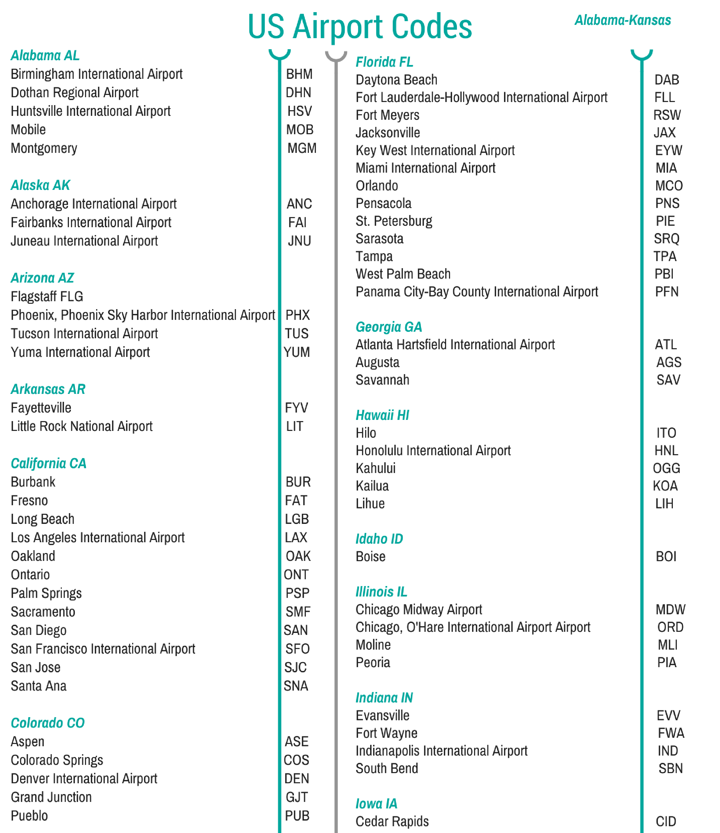
Map
40,000+ listed airports
…

Slide 32
Map
Map: a collection of <key, value> pairs
(<"TLV", "Tel Aviv">, <"MUM", "Mumbai">, …)
key
value
TLV
MUM
LON
NYC
...
Tel Aviv
Mumbai
London
New York
...
40,000+ listed airports
Objective: Given a key, get its value, fast
Map: A data structure designed to support this requirement

Slide 33


Map
Map: a collection of <key, value> pairs
Data (example):
Animals, and
animal sounds
(<"Cow", "Moo">, <"Dog", "Woof">, …)
key
value
moo
woof
Cow
Dog
Mouse
Cat
...
Moo
Woof
Squeek
Miao
...
In Java: The map data structure is implemented by a generic class named HashMap
Objective: Given a key, get its value, fast
Map: A data structure designed to support this requirement

Slide 34
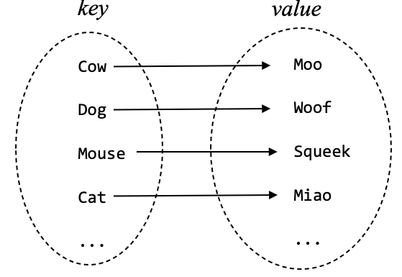
Map
/** Represents a generic map.
* Maps objects of type K on objects of type V.
* K and V can be any class. */
public class HashMap<K,V> {
// API: Illustrated below (by usage examples)
// Implementation: Later
Data (example):
Animals, and
animal sounds
Client code (example):
moo
woof
// Constructs a map of < String , String > pairs
HashMap<String,String> animalSound = new HashMap<String,String>();
In Java: The map data structure is implemented by a generic class named HashMap

Slide 35
Map
/** Represents a generic map.
* Maps objects of type K on objects of type V.
* K and V can be any class. */
public class HashMap<K,V> {
// API: Illustrated below (by usage examples)
// Implementation: Later
Data (example):
Animals, and
animal sounds
Client code (example):
moo
woof
// Constructs a map of < String , String > pairs
HashMap<String,String> animalSound = new HashMap<String,String>();
animalSound: An object of type HashMap, that maps strings on strings
In Java: The map data structure is implemented by a generic class named HashMap

Slide 36
Map
/** Represents a generic map.
* Maps objects of type K on objects of type V.
* K and V can be any class. */
public class HashMap<K,V> {
// API: Illustrated below (by usage examples)
// Implementation: Later
Data (example):
Animals, and
animal sounds
Client code (example):
moo
woof
// Constructs a map of < String , String > pairs
HashMap<String,String> animalSound = new HashMap<String,String>();
// Puts some pairs in the map
animalSound.put("dog", "woof");
animalSound.put("cat", "miao");
animalSound.put("cow", "moo");
animalSound.put("mouse", "squeak");
In Java: The map data structure is implemented by a generic class named HashMap
put(key, value): A HashMap method that adds the pair <key, value> to the map

Slide 37
Map
/** Represents a generic map.
* Maps objects of type K on objects of type V.
* K and V can be any class. */
public class HashMap<K,V> {
// API: Illustrated below (by usage examples)
// Implementation: Later
Data (example):
Animals, and
animal sounds
Client code (example):
moo
woof
// Constructs a map of < String , String > pairs
HashMap<String,String> animalSound = new HashMap<String,String>();
// Puts some pairs in the map
animalSound.put("dog", "woof");
animalSound.put("cat", "miao");
animalSound.put("cow", "moo");
animalSound.put("mouse", "squeak");
// Uses the map
System.out.println("Cow goes " + animalSound.get("cow"));
System.out.println("Mouse goes " + animalSound.get("mouse"));
In Java: The map data structure is implemented by a generic class named HashMap
get(key): A HashMap method that returns
the value associated with key

Slide 38
Map
/** Represents a generic map.
* Maps objects of type K on objects of type V.
* K and V can be any class. */
public class HashMap<K,V> {
// API: Illustrated below (by usage examples)
// Implementation: Later
Data (example):
Animals, and
animal sounds
Client code (example):
moo
woof
// Constructs a map of < String , String > pairs
HashMap<String,String> animalSound = new HashMap<String,String>();
// Puts some pairs in the map
animalSound.put("dog", "woof");
animalSound.put("cat", "miao");
animalSound.put("cow", "moo");
animalSound.put("mouse", "squeak");
// Uses the map
System.out.println("Cow goes " + animalSound.get("cow"));
System.out.println("Mouse goes " + animalSound.get("mouse"));
cow goes moo
mouse goes squeak
get(key): A HashMap method that returns
the value associated with key

Slide 39
Map
/** Represents a generic map.
* Maps objects of type K on objects of type V.
* K and V can be any class. */
public class HashMap<K,V> {
// API: Illustrated below (by usage examples)
// Implementation: Later
Data (example):
Animals, and
animal sounds
Client code (example):
moo
woof
// Constructs a map of < String , String > pairs
HashMap<String,String> animalSound = new HashMap<String,String>();
// Puts some pairs in the map
animalSound.put("dog", "woof");
animalSound.put("cat", "miao");
animalSound.put("cow", "moo");
animalSound.put("mouse", "squeak");
// Uses the map
System.out.println("Cow goes " + animalSound.get("cow"));
System.out.println("Mouse goes " + animalSound.get("mouse"));
for (String sound: animalSound.values()) {
System.out.println(sound);
}
...
cow goes moo
mouse goes squeak
squeak
miao
moo
woof
values(): A HashMap method that returns all the V values in the map, as an iterable Collection type

Slide 40
Map: Behind the scene
key,
value:
a collection of <key, value> pairs
animal, sound:
(<"Cow", "Moo">, <"Dog", "Woof">, …)
title, fileName:
(<"Let It Be", "letItBe.wav">, <"Imagine", "q63hjbk.wav">,…)
ID, student:
(<7237233, Ben>, <652662, Netta>, …)
symbol, address:
(<"x", 20007363>, <"sum", 75400217>, …)
. . .

Slide 41
Map: Behind the scene
key,
value:
a collection of <key, value> pairs
animal, sound:
(<"Cow", "Moo">, <"Dog", "Woof">, …)
key
value
Cow
Dog
Mouse
Cat
...
Moo
Woof
Squeek
Miao
...
Observation
At bottom, keys and values of any type are represented as numbers.

Slide 42
Map: Behind the scene
key,
value:
a collection of <key, value> pairs
animal, sound:
(<"Cow", "Moo">, <"Dog", "Woof">, …)
key
value
63
321
3
7009
...
9
6
573
16
...
Observation
At bottom, keys and values of any type are represented as numbers.

Slide 43
Map: Behind the scene
Map
key value
0
63 9
321 6
3 573
7009 16
143 8
2
...
1
h(key) =
key % 10 =
2
Array of linked lists
. . .
3
...
9
N = 10 (load factor)

Slide 44
Map: Behind the scene
Map
key value
0
63 9
321 6
3 573
7009 16
143 8
2
...
1
h(key) =
key % 10 =
2
. . .
3
63
9
...
9
N = 10 (load factor)

Slide 45
Map: Behind the scene
Map
key value
0
63 9
321 6
3 573
7009 16
143 8
2
...
1
h(key) =
key % 10 =
2
. . .
3
63
9
...
9
N = 10 (load factor)

Slide 46
Map: Behind the scene
Map
key value
0
63 9
321 6
3 573
7009 16
143 8
2
...
1
321
6
h(key) =
key % 10 =
2
. . .
3
63
9
...
9
N = 10 (load factor)

Slide 47
Map: Behind the scene
Map
key value
0
63 9
321 6
3 573
7009 16
143 8
2
...
1
321
6
h(key) =
key % 10 =
2
. . .
3
63
9
...
9
N = 10 (load factor)

Slide 48
Map: Behind the scene
Map
key value
0
63 9
321 6
3 573
7009 16
143 8
2
...
1
321
6
h(key) =
key % 10 =
2
. . .
3
63
9
3
573
...
9
N = 10 (load factor)

Slide 49
Map: Behind the scene
Map
key value
0
63 9
321 6
3 573
7009 16
143 8
2
...
1
321
6
h(key) =
key % 10 =
2
. . .
3
63
9
3
573
...
9
N = 10 (load factor)

Slide 50
Map: Behind the scene
Map
key value
0
63 9
321 6
3 573
7009 16
143 8
2
...
1
321
6
h(key) =
key % 10 =
2
. . .
3
63
9
3
573
...
9
7009
16
N = 10 (load factor)

Slide 51
Map: Behind the scene
Map
key value
0
63 9
321 6
3 573
7009 16
143 8
2
...
1
321
6
h(key) =
key % 10 =
2
. . .
3
63
9
3
573
...
9
7009
16
N = 10 (load factor)

Slide 52
Map: Behind the scene
Map
key value
0
63 9
321 6
3 573
7009 16
143 8
2
...
1
321
6
h(key) =
key % 10 =
2
. . .
3
63
9
3
573
143
8
...
9
7009
16
N = 10 (load factor)

Slide 53
Map: Behind the scene
Map
key value
0
63 9
321 6
3 573
7009 16
143 8
2
...
1
321
6
h(key) =
key % 10 =
2
. . .
3
63
9
3
573
143
8
...
9
7009
16
N = 10 (load factor)

Slide 54
Map: Behind the scene
Map
key value
0
63 9
321 6
3 573
7009 16
143 8
2
...
1
321
6
11
2
h(key) =
key % 10 =
2
. . .
3
63
9
3
573
143
8
...
9
7009
16
N = 10 (load factor)

Slide 55
Map (implementations also called map, hash map, hash table)
Map
key value
0
63 9
321 6
3 573
7009 16
143 8
2
...
1
321
6
11
2
h(key) =
key % 10 =
2
. . .
3
63
9
3
573
143
8
...
9
7009
16
N = 10 (load factor)
put(key , value)
Compute h(key)
Add a node to the list
Super fast
get(key)
Compute h(key)
Search the list
Fast (if the lists are short)
Access time
Depends on N, the load factor
The larger is N, the shorter is the average list length

Slide 56
Map (implementations also called map, hash map, hash table)
Map
key value
0
63 9
321 6
3 573
7009 16
143 8
2
...
1
321
6
11
2
h(key) =
key % 10 =
2
. . .
3
63
9
3
573
143
8
...
9
7009
16
N = 10 (load factor)
Map: A highly efficient, widely used, data structure.

